Slide 1

Automated builds CI + CD
Carlos Arnau

Slide 2

Table of contents
Introduction to CI and CD
Automatic builds with GitHub Actions
How to write scripts
Automatic upload to GitHub
Automatic builds and notifications

Slide 3
What is CI/CD?

Slide 4
CI
CD
(Continuous integration)
(Continuous delivery and/or
continuous deployment)

Slide 5
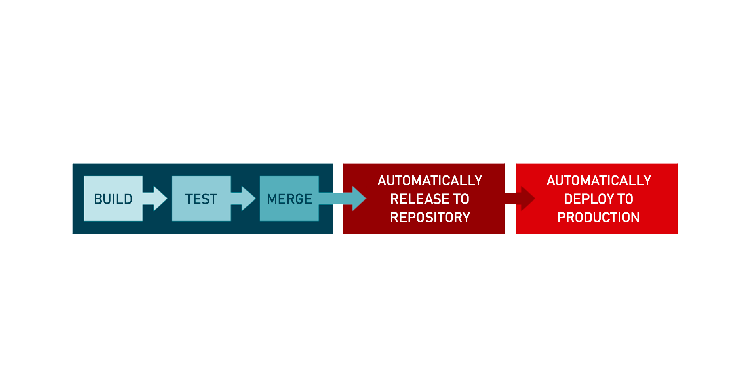

Slide 6
Automatic builds with GitHub Actions

Slide 7


Slide 8
Why should you use GitHub actions?
Avoid having the problems of “It worked on my machine when I built it”.
Eliminate the human error possibility
Validate that your builds are running on different platforms.

Slide 9
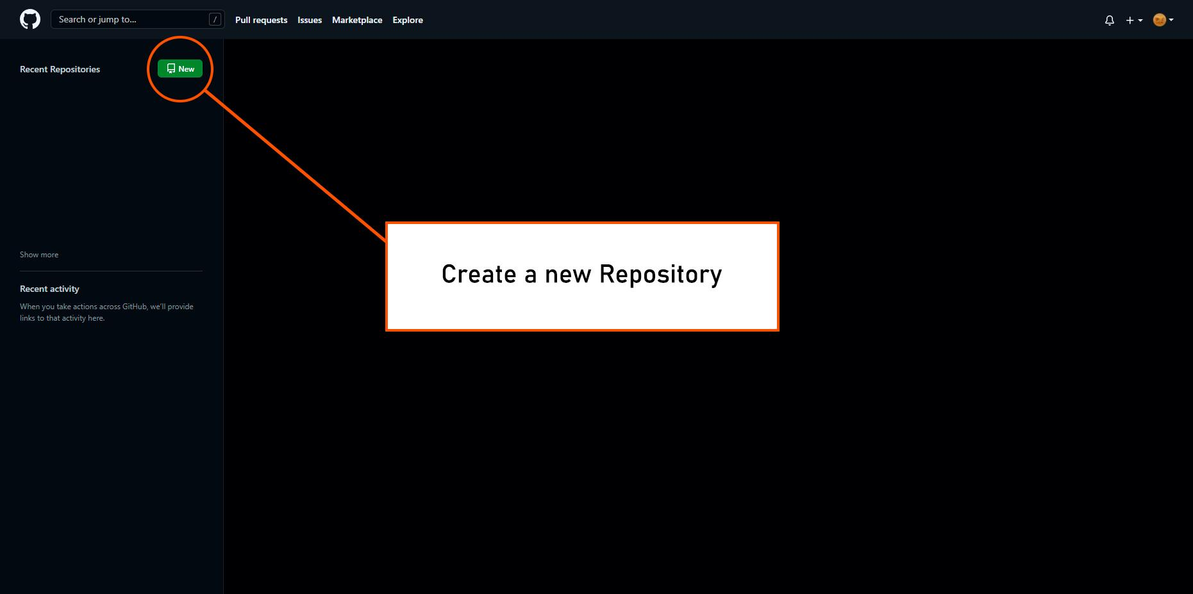

Slide 10
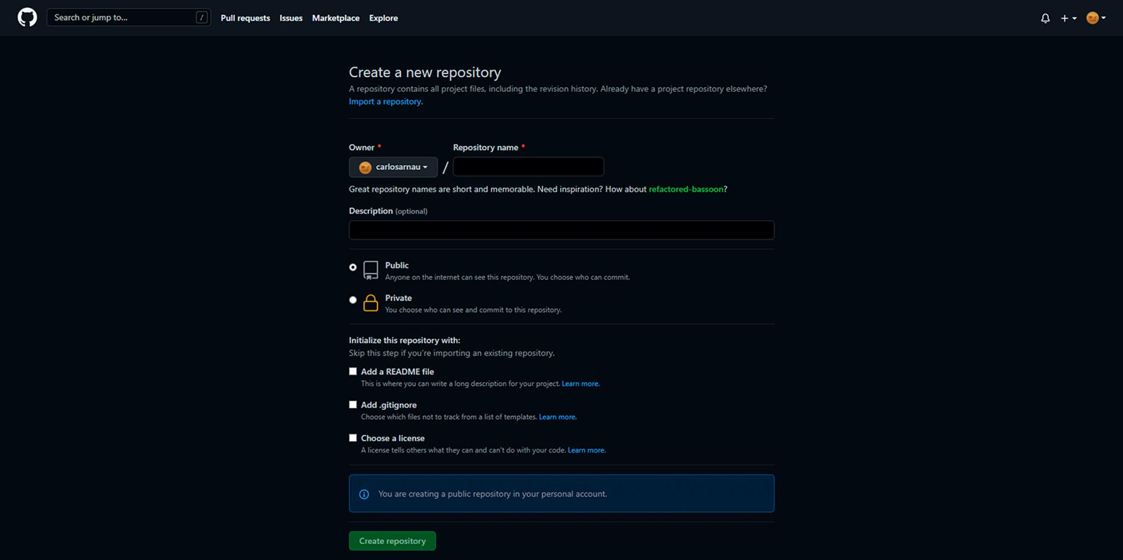

Slide 11
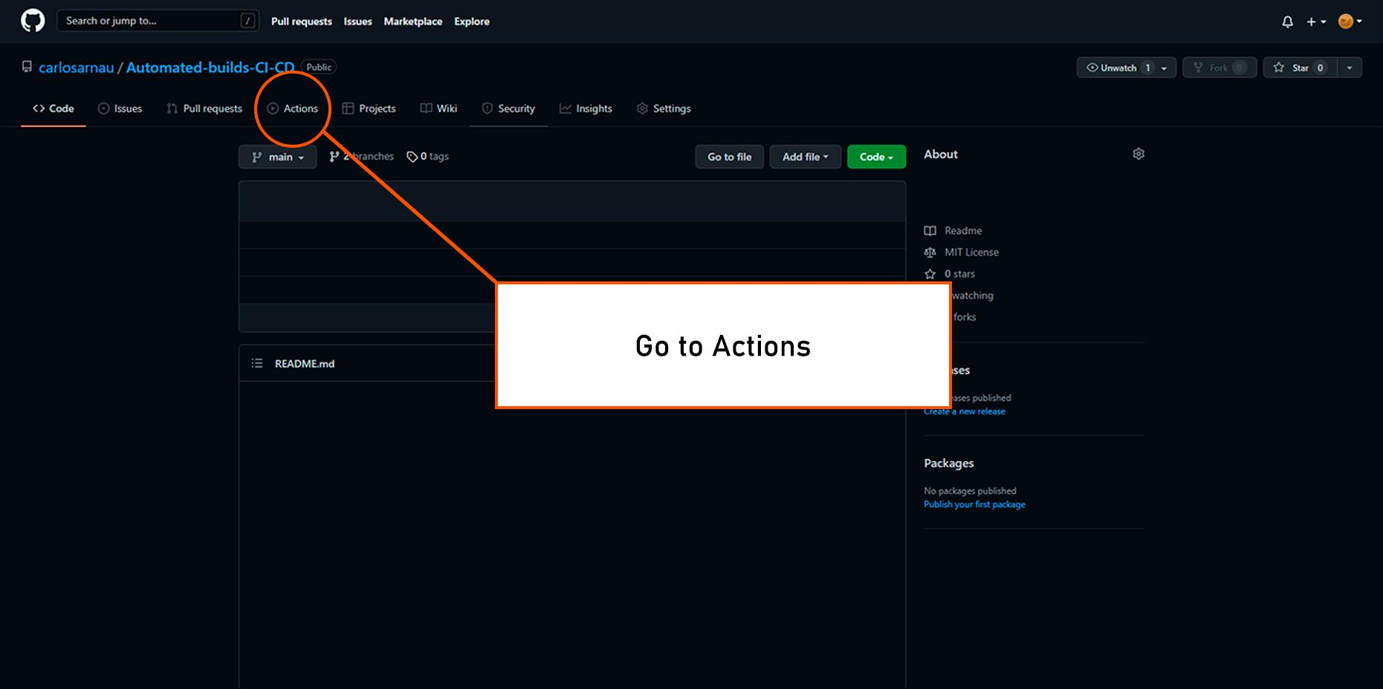

Slide 12
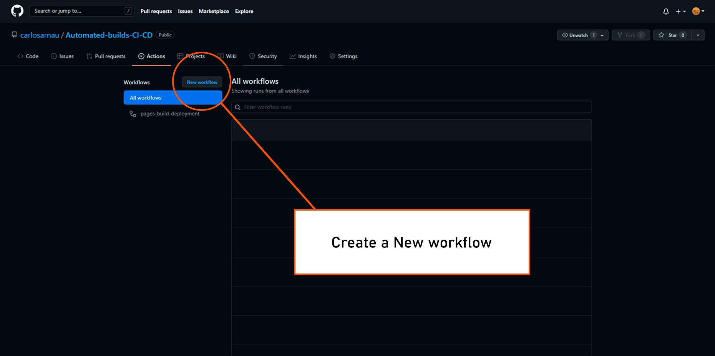

Slide 13
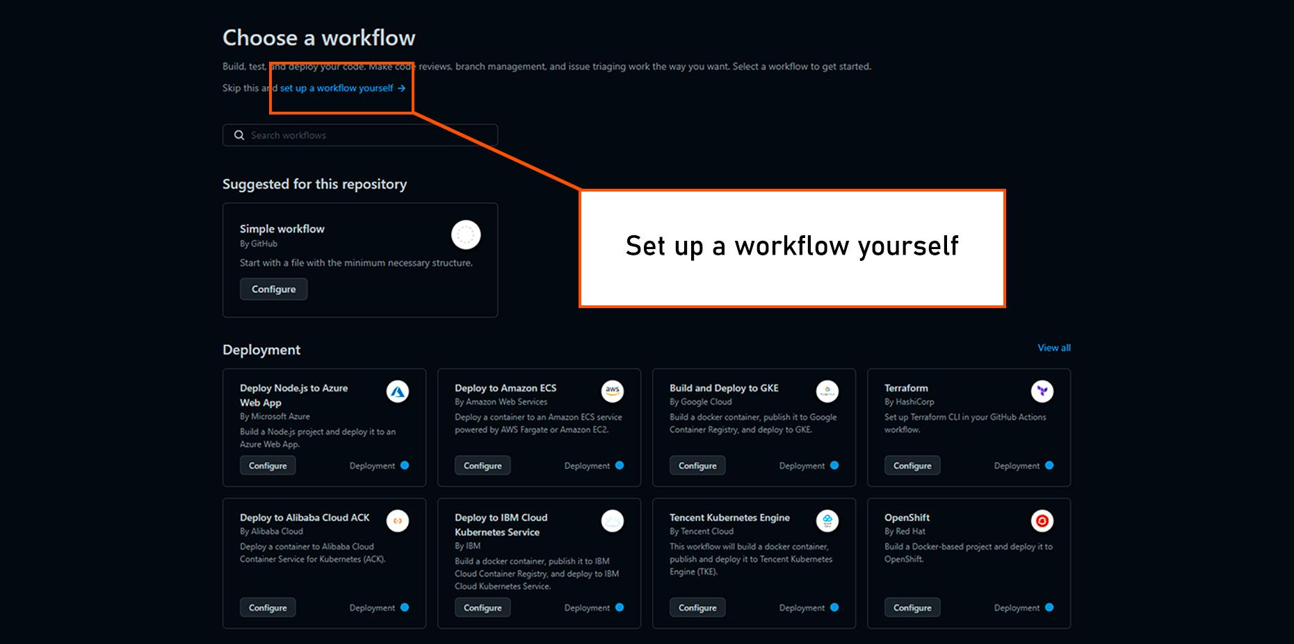

Slide 14
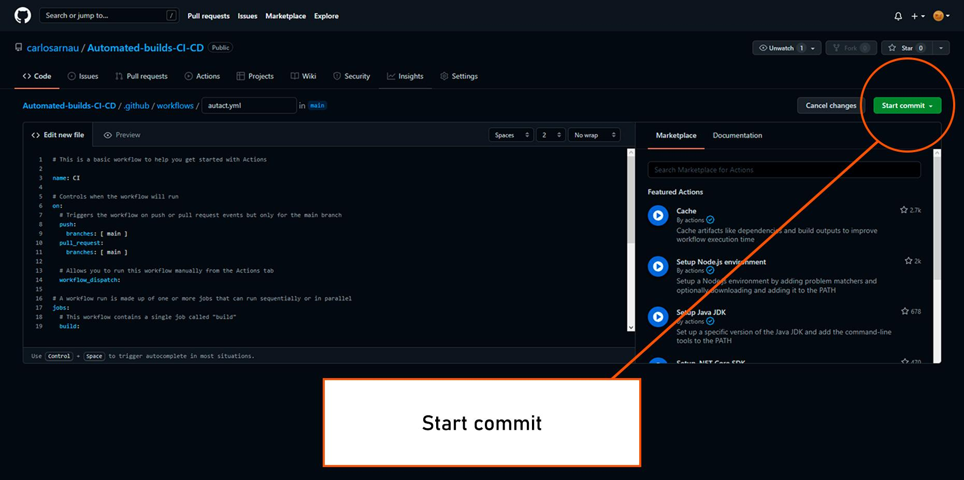

Slide 15
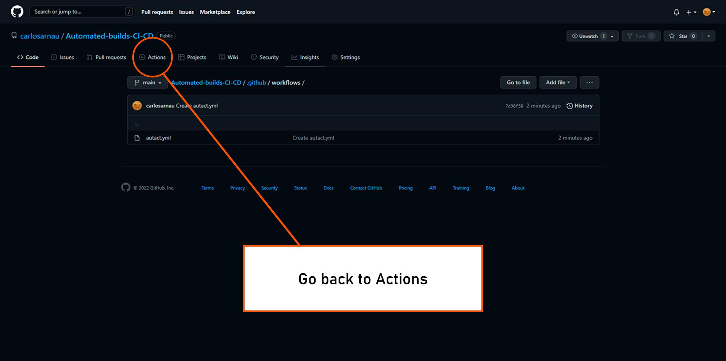

Slide 16
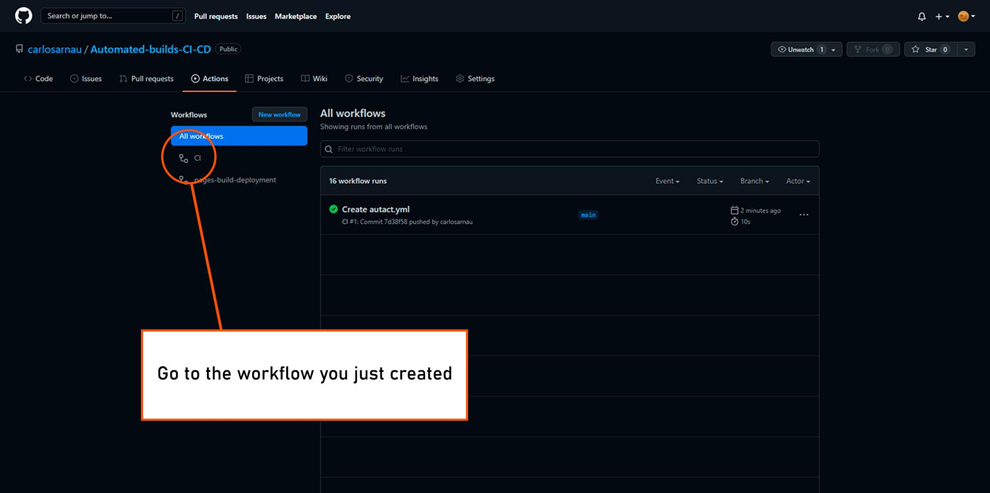

Slide 17
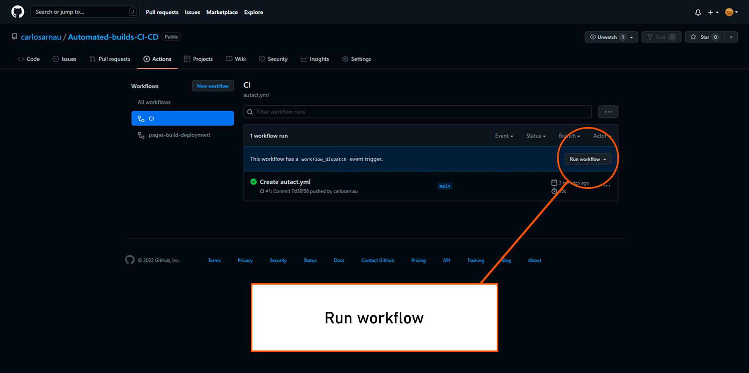

Slide 18
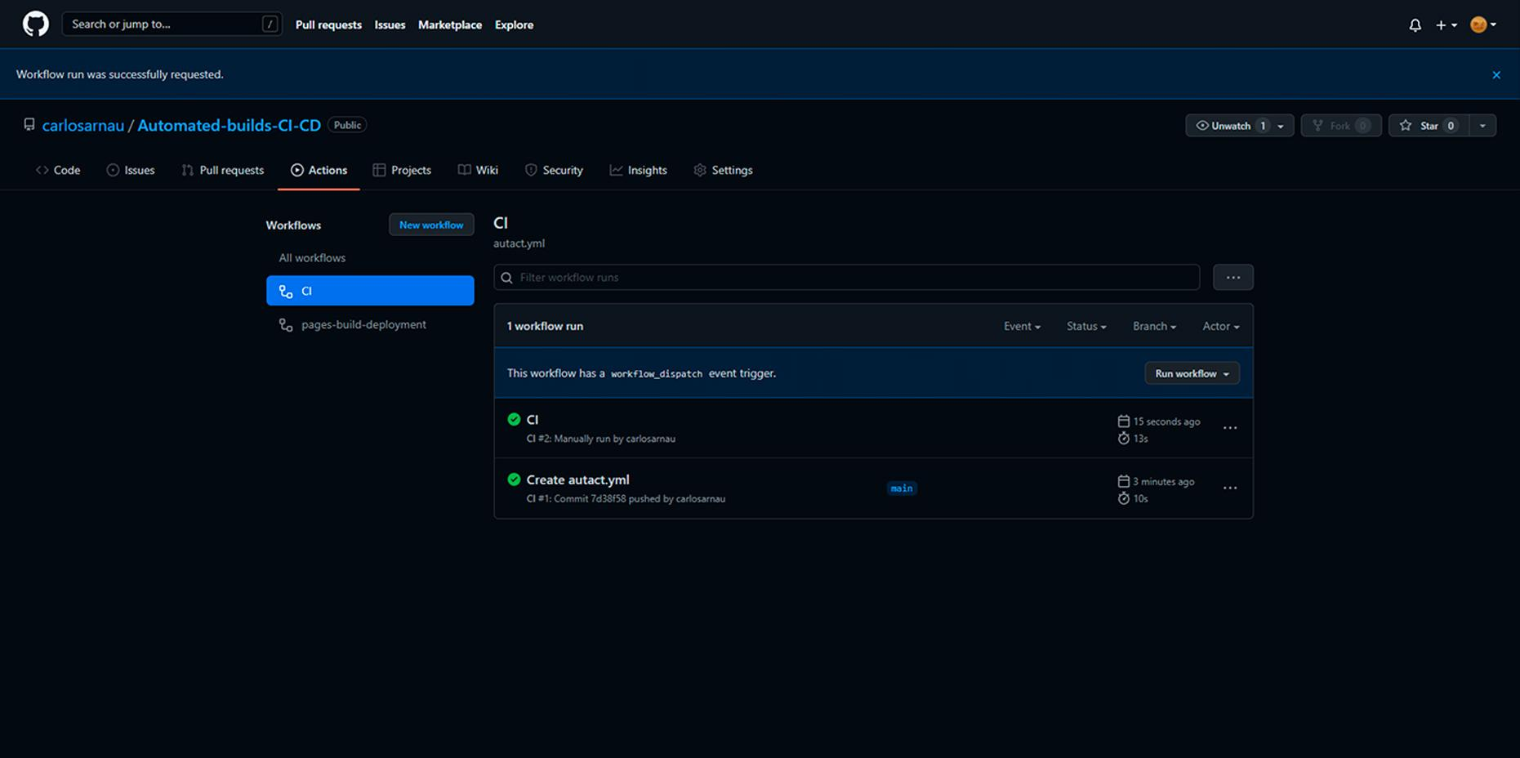

Slide 19
How to write Scripts

Slide 20
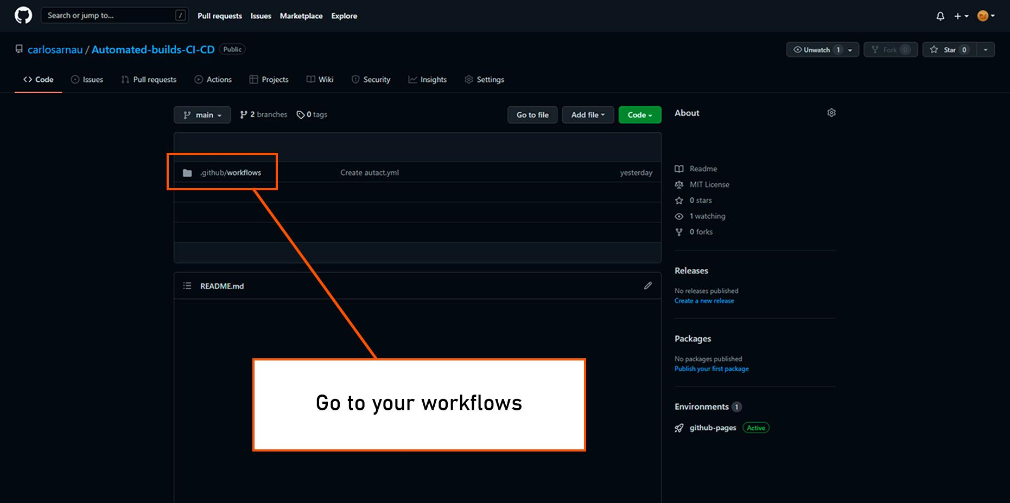

Slide 21
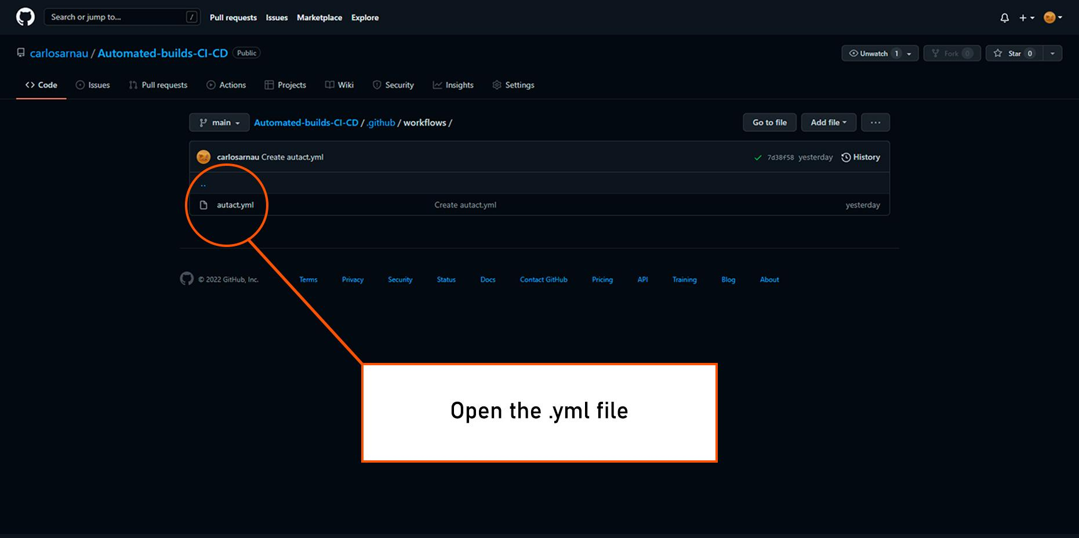

Slide 22
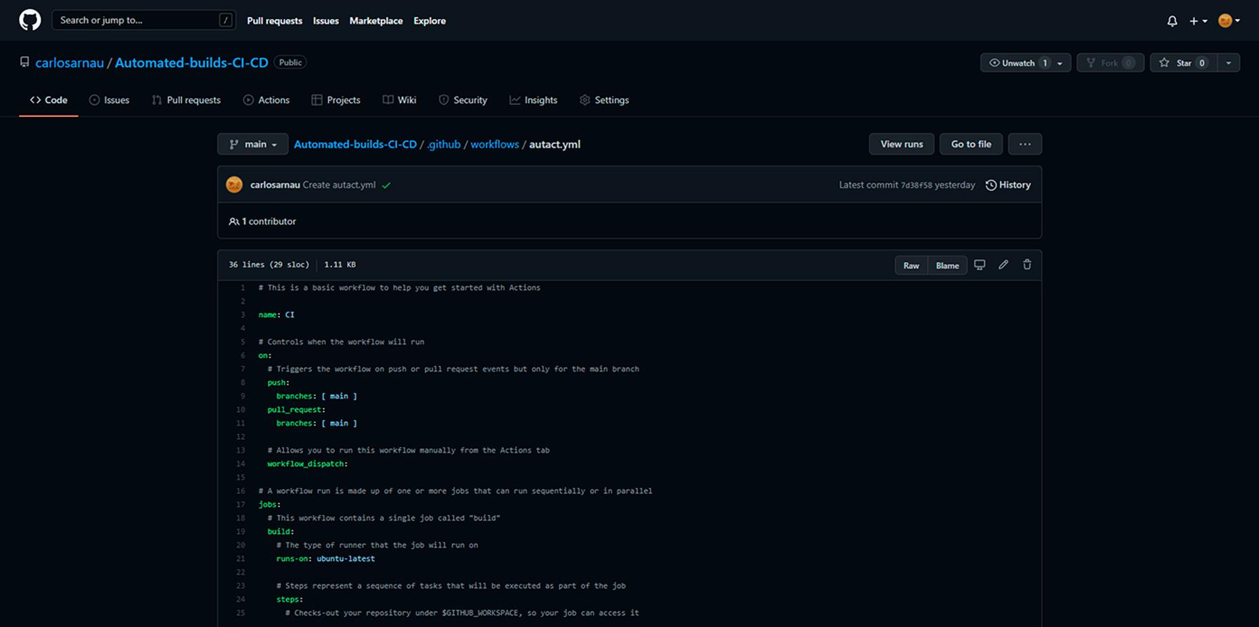
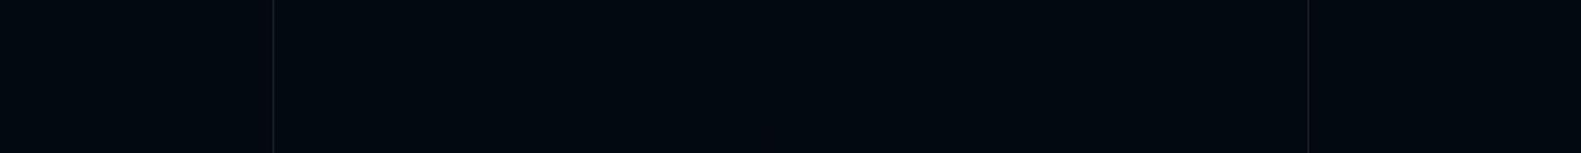

Slide 23
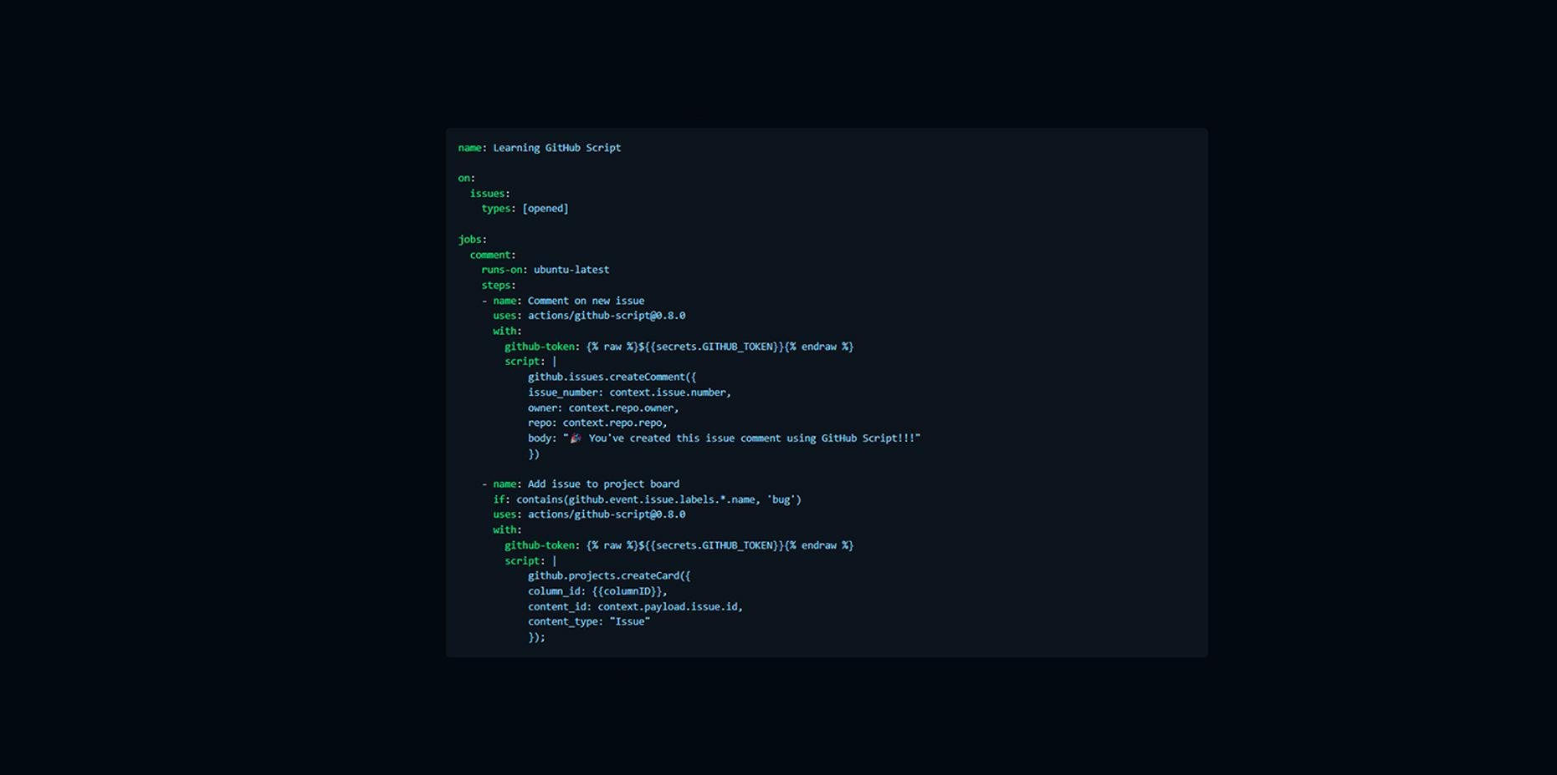

Slide 24
Automatic upload to GitHub

Slide 25
name: Create release
on:
release:
types:
- created
jobs:
build:
runs-on: ubuntu-latest
steps:
- uses: actions/checkout@v2
- name: Get Composer Cache Directory
id: composer-cache
run: |
echo "::set-output name=dir::$(composer config cache-files-dir)"
- uses: actions/cache@v2
with:
path: ${{ steps.composer-cache.outputs.dir }}
key: ${{ runner.os }}-composer-${{ hashFiles('**/composer.lock') }}
restore-keys: |
${{ runner.os }}-composer-
- name: Install dependencies
run: |
composer install -o -q
- name: Zip Folder
run: zip -r ${{ github.event.repository.name }}.zip . -x ".git/*" ".github/*" "phpcs.xml" "composer.json" "composer.lock" ".gitignore"
- name: Release
uses: softprops/action-gh-release@v1
if: startsWith(github.ref, 'refs/tags/')
with:
files: ${{ github.event.repository.name }}.zip
env:
GITHUB_TOKEN: ${{ secrets.GITHUB_TOKEN }}

Slide 26
name: Create release
on:
release:
types:
- created

Slide 27
runs-on: ubuntu-latest
steps:
- uses: actions/checkout@v2
- name: Get Composer Cache Directory
id: composer-cache
run: |
echo "::set-output name=dir::$(composer config cache-files-dir)"
- uses: actions/cache@v2
with:
path: ${{ steps.composer-cache.outputs.dir }}
key: ${{ runner.os }}-composer-${{ hashFiles('**/composer.lock') }}
restore-keys: |
${{ runner.os }}-composer-
- name: Install dependencies
run: |
composer install -o -q
- name: Zip Folder
run: zip -r ${{ github.event.repository.name }}.zip . -x ".git/*" ".github/*" "phpcs.xml" "composer.json" "composer.lock" ".gitignore"
- name: Release
uses: softprops/action-gh-release@v1
if: startsWith(github.ref, 'refs/tags/')
with:
files: ${{ github.event.repository.name }}.zip
env:
GITHUB_TOKEN: ${{ secrets.GITHUB_TOKEN }}

Slide 28
Automatic builds and notifications

Slide 29
Notification settings

Slide 30
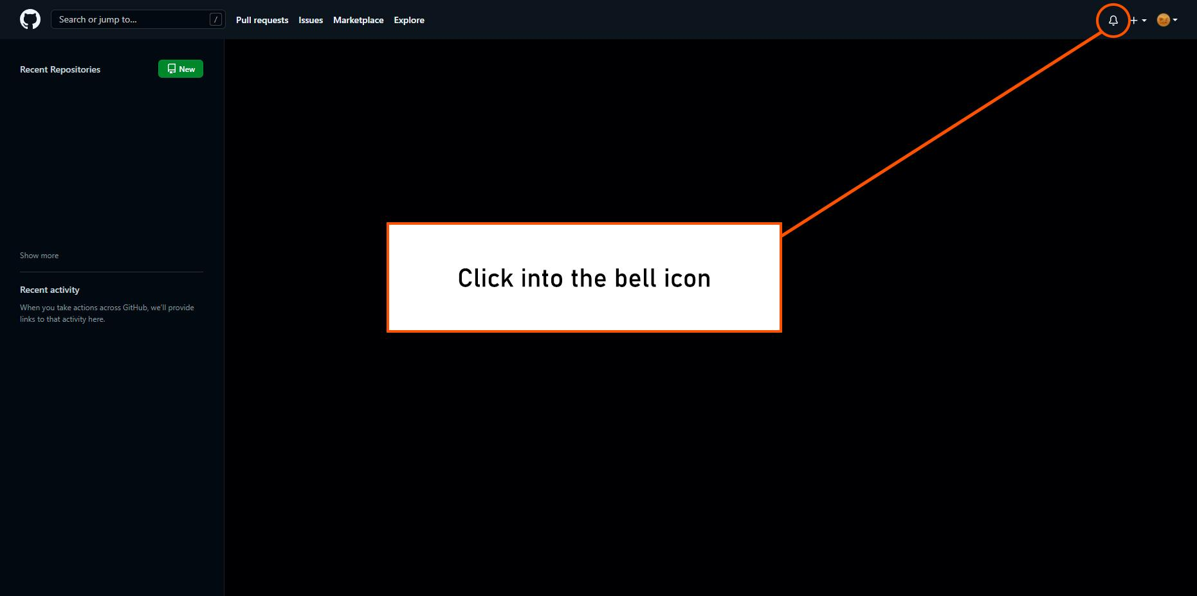

Slide 31
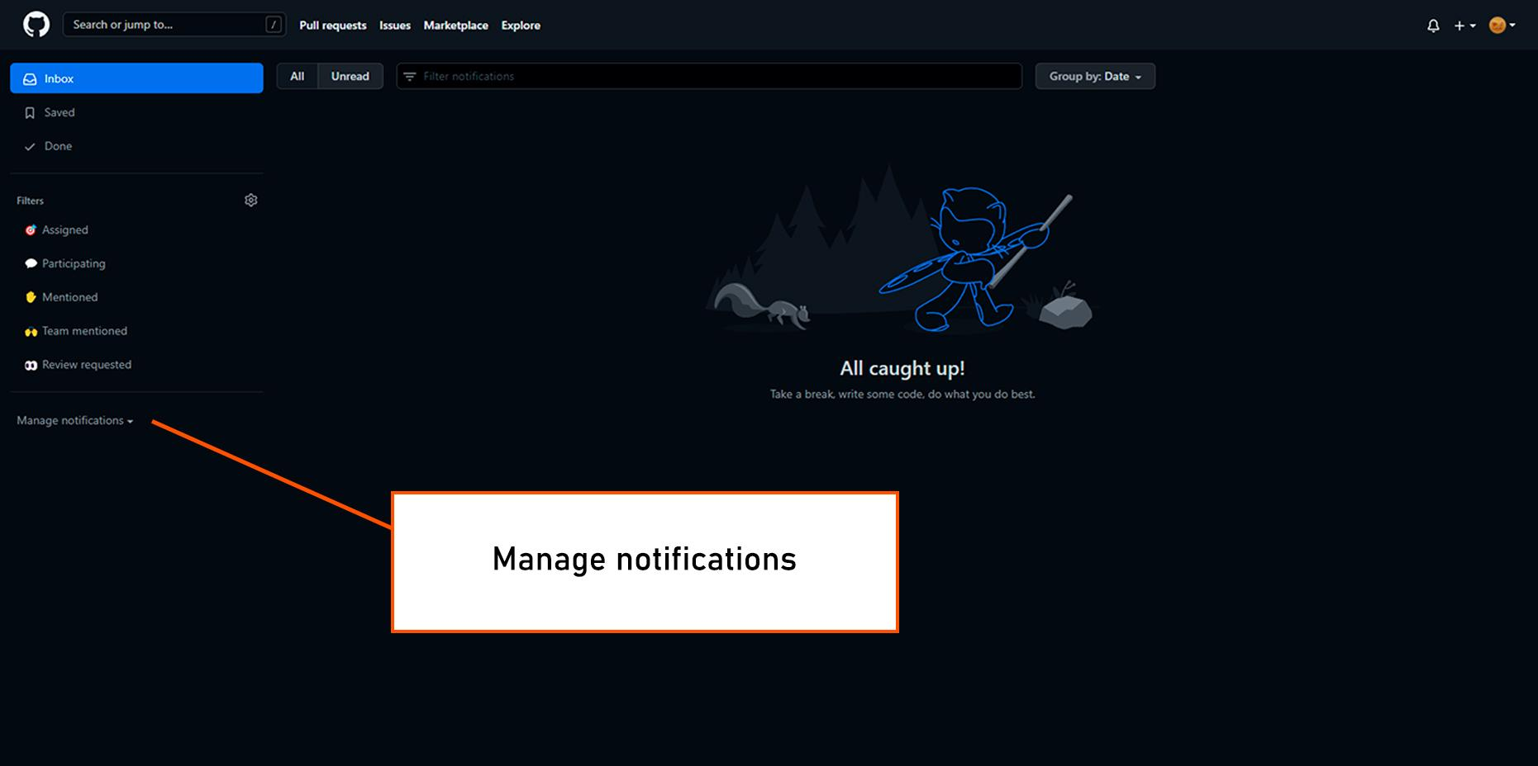

Slide 32
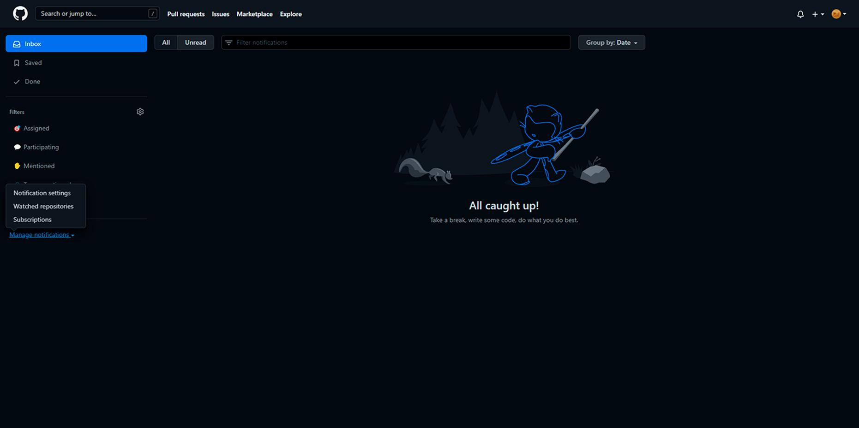

Slide 33
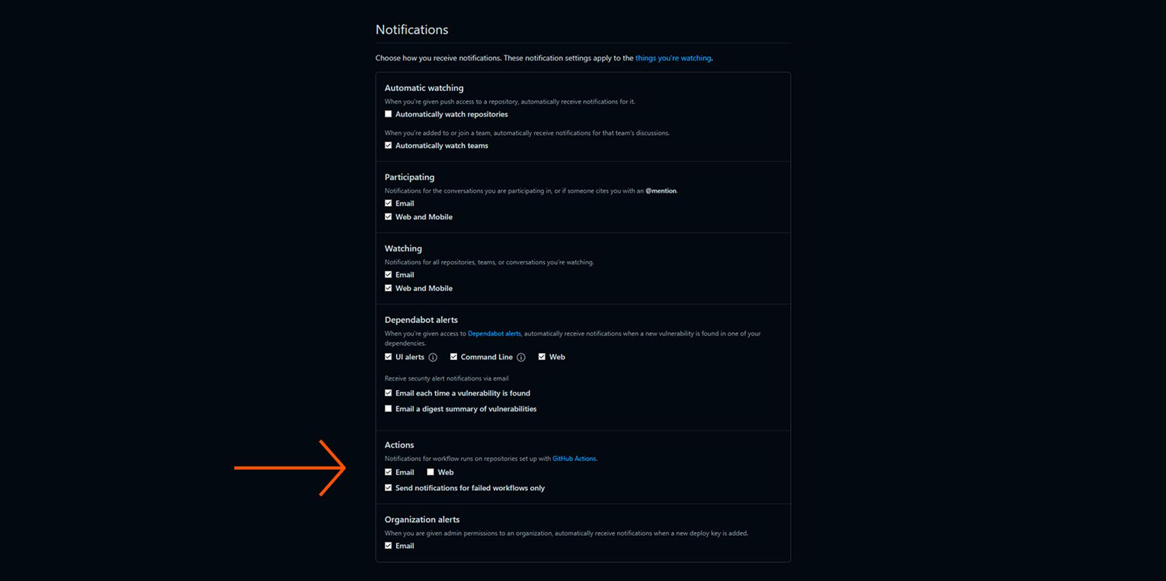

Slide 34
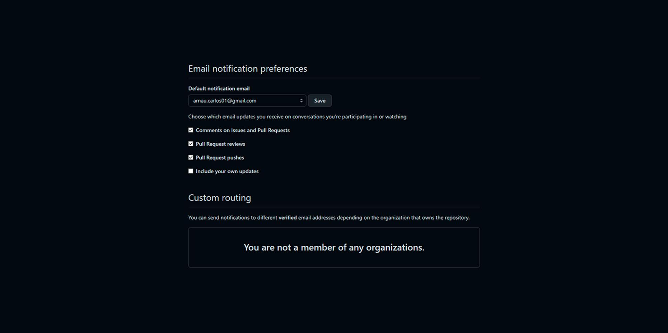

Slide 35
Subscriptions

Slide 37
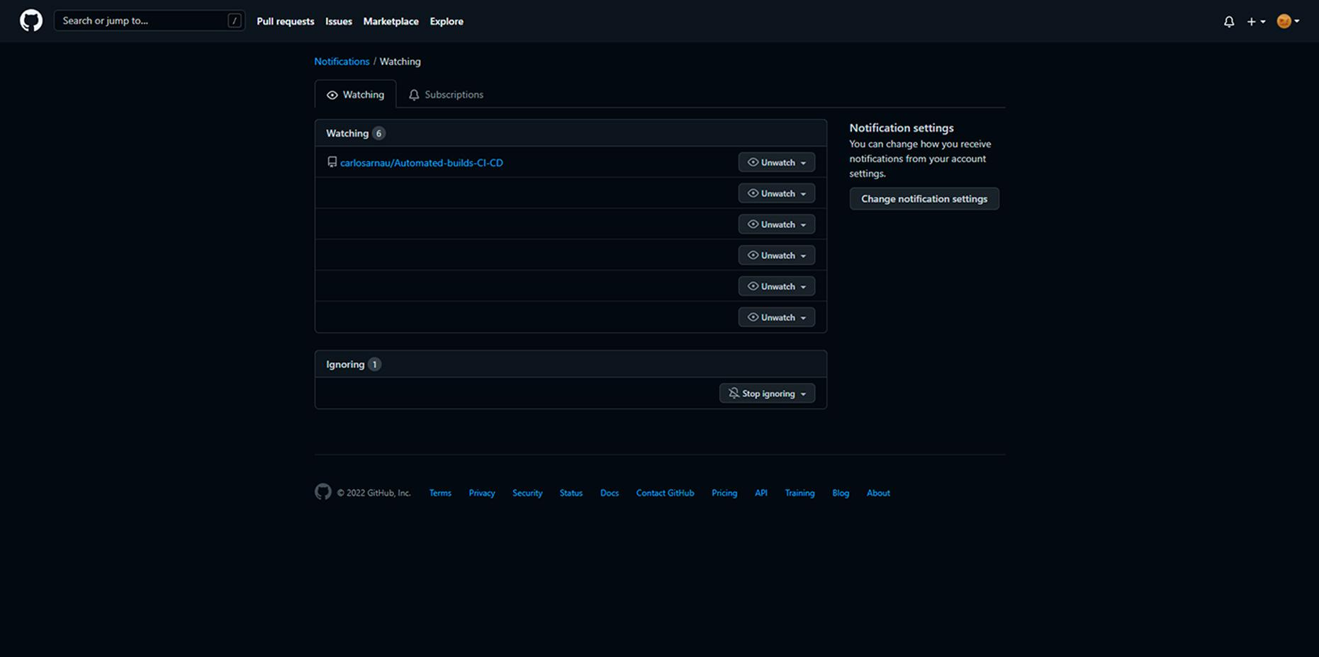

Slide 38
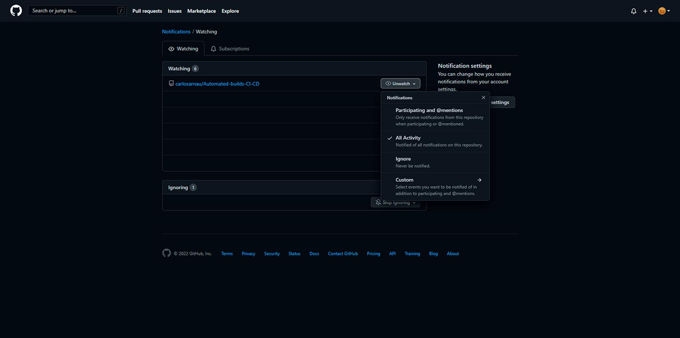

Slide 39
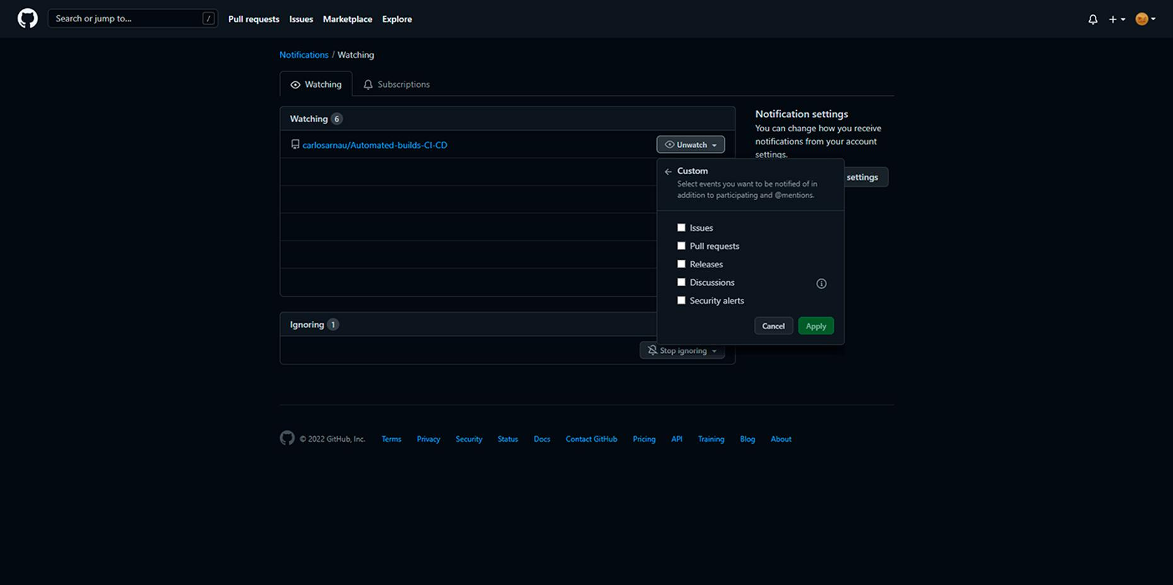

Slide 40
Thanks for your attention

Slide 41
Webgraphy
What is CI/CD? -> <https://www.redhat.com/en/topics/devops/what-is-ci-cd>
Intro to Continuous Integration, Continuous Delivery, and Continuous Deployment -> <https://www.indellient.com/blog/whats-the-difference-between-continuous-integration-continuous-delivery-and-continuous-deployment/>
Continuous integration vs. delivery vs. deployment -> <https://www.atlassian.com/continuous-delivery/principles/continuous-integration-vs-delivery-vs-deployment>
Understanding GitHub Actions -> <https://docs.github.com/en/actions/learn-github-actions/understanding-github-actions>
How to Use Github Actions to Automate Your Repository Builds -> <https://www.cloudsavvyit.com/15207/how-to-use-github-actions-to-automate-your-repository-builds/>
CI/CD for C/C++ games using GitHub Actions -> <https://thatonegamedev.com/cpp/ci-cd-for-c-c-games-using-github-actions/>
How to automate the MSI Building with GitHub Actions -> <https://www.youtube.com/watch?v=T_Rj3_M-m8I>
Introduction to Markdown: <https://www.ionos.es/digitalguide/paginas-web/desarrollo-web/tutorial-de-markdown/>

